Slide 1
FORMERLY-Math
Constrained Form-Finding through Membrane Equilibrium Analysis in Mathematica
https://github.com/colivieri89/FORMERLY-Math
C. Olivieri
Department of Civil Engineering (DICIV), University of Salerno, Via Giovanni Paolo II, 132, 84084 Fisciano, SA, Italy
colivieri@unisa.it
https://github.com/colivieri89/FORMERLY-Math
1/29

Slide 2
What is FORMERLY-Math?
FORMERLY-Math: Constrained Form-Finding through Membrane Equilibrium Analysis in Mathematica
It is a package designed for the form-finding of compressed or tensile membranes in Mathematica.
Mission:
static assessment method for masonry vaults within the framework of Limit Analysis;
searching for efficient new forms in structural design.
https://github.com/colivieri89/FORMERLY-Math
2/29

Slide 3
FORMERLY-Math Modules
Pre-processing
Reference Shape Definition
Constrained Form Finding
Stresses Evaluation and Outputs
https://github.com/colivieri89/FORMERLY-Math
3/29

Slide 4
https://github.com/colivieri89/FORMERLY-Math
4/29

Slide 5
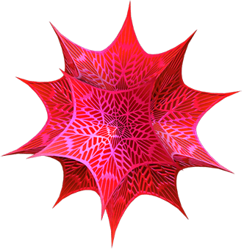
Software
FORMERLY-Math is compatible with the proprietary software Wolfram Mathematica© (run successfully on versions 11.2, 12.1, and 13.0)
https://github.com/colivieri89/FORMERLY-Math
5/29

Slide 6
Pre-Processing
https://github.com/colivieri89/FORMERLY-Math
6/29

Slide 7
Pre-processing
Initializing
Load the required packages (NDSolve 'FEM’ and Notation) by running the sub-module.
https://github.com/colivieri89/FORMERLY-Math
7/29

Slide 8
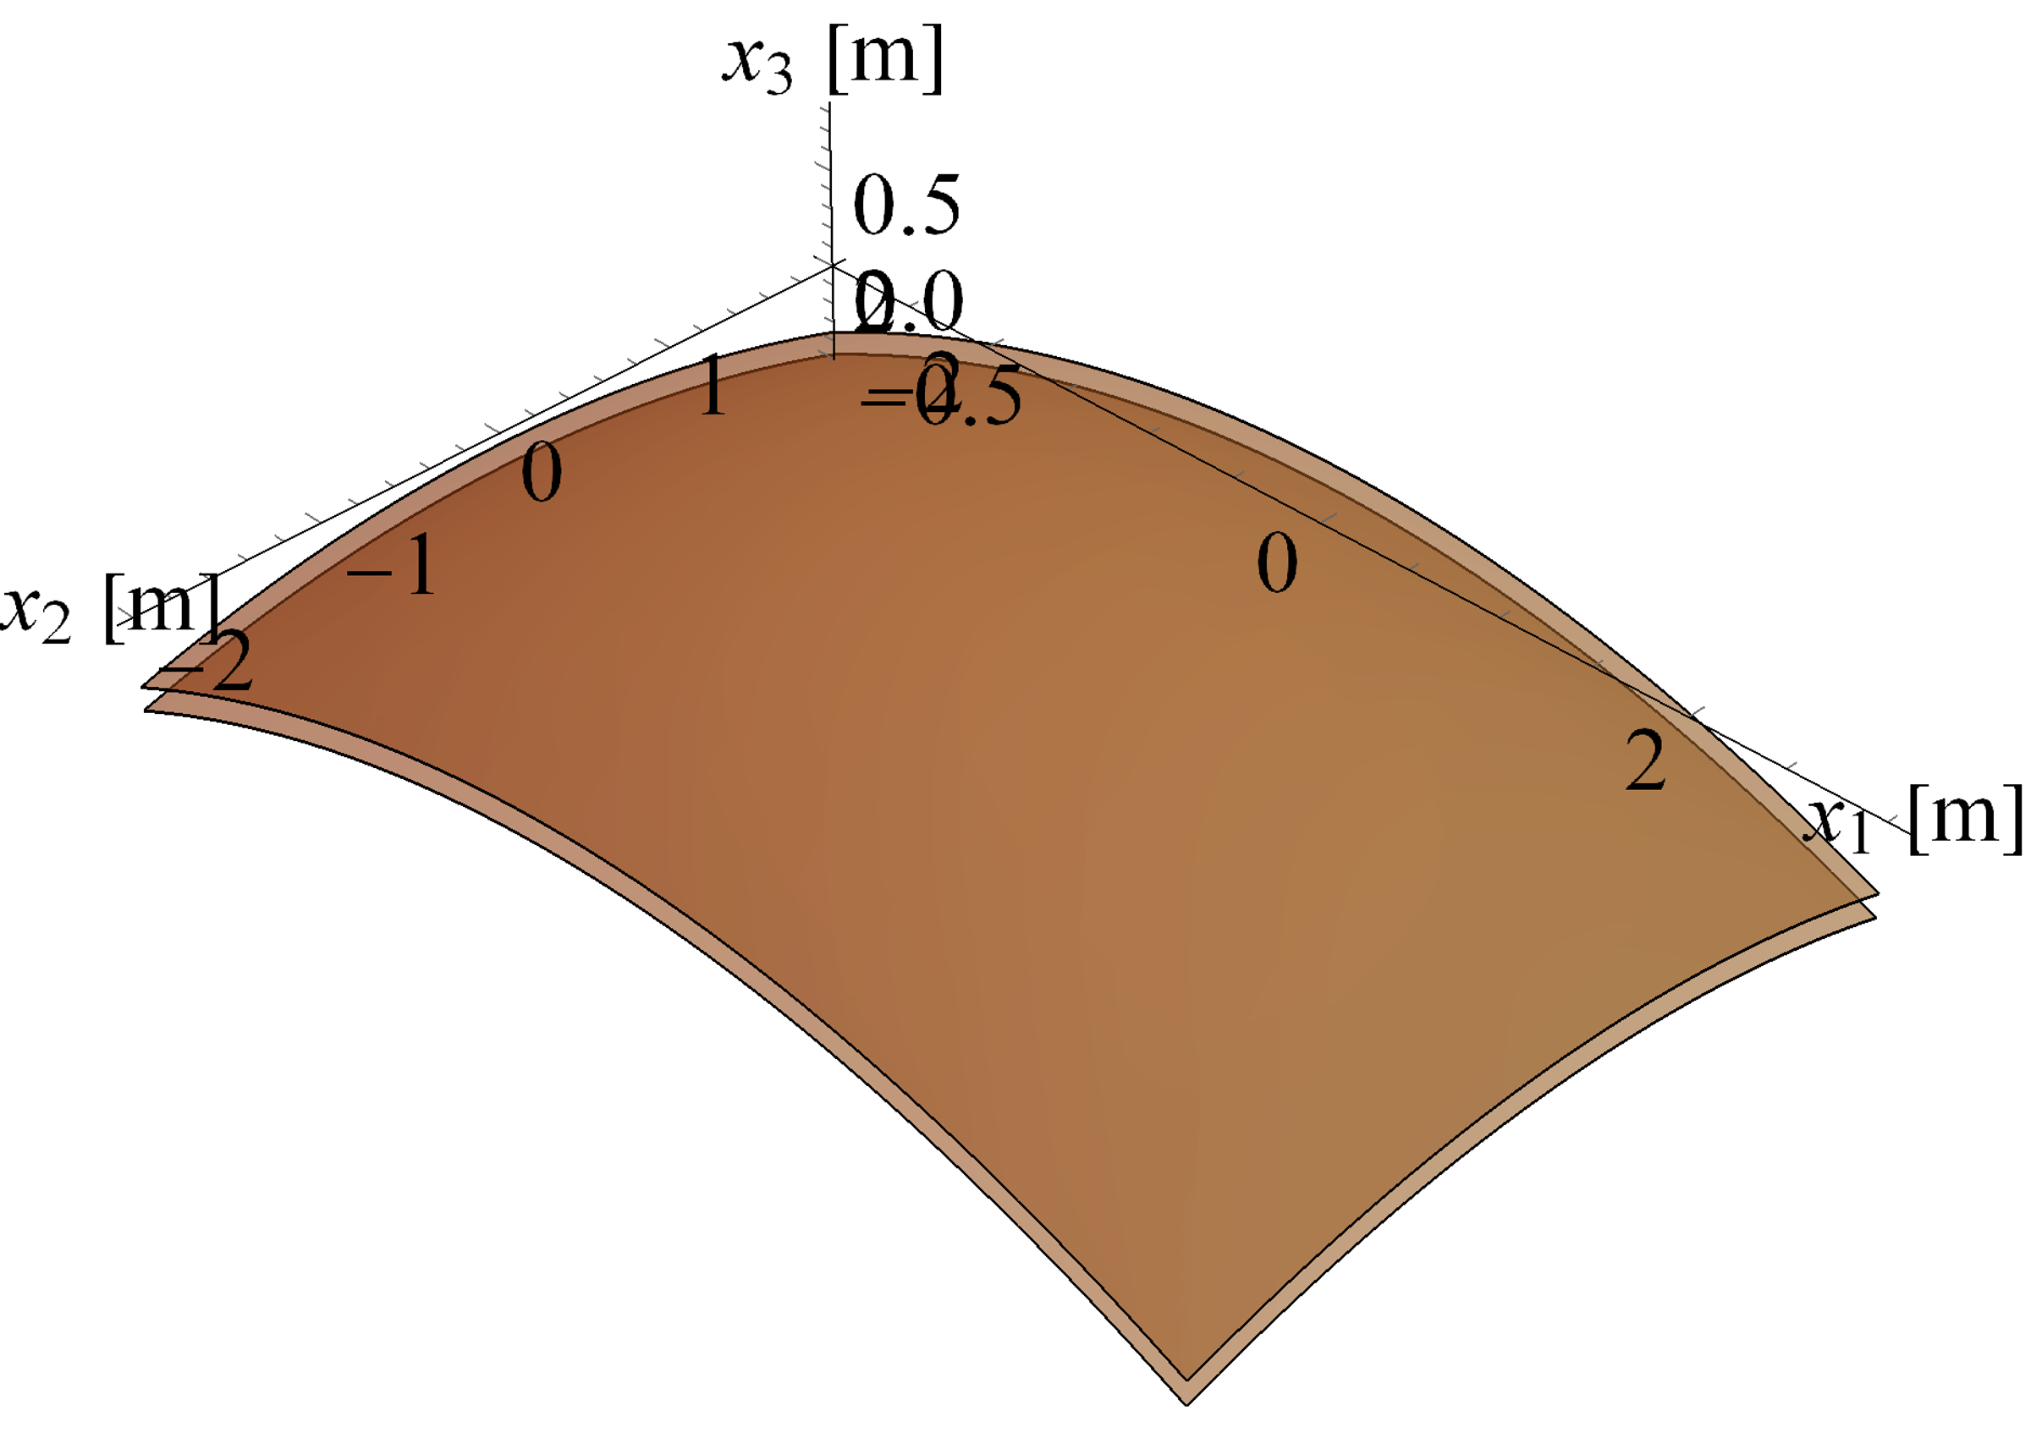
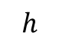
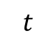

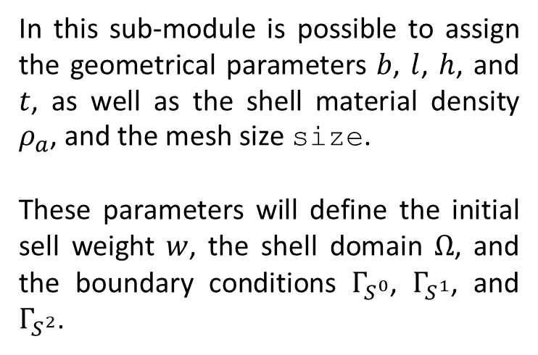

Pre-processing
Data
In this sub-module is possible to assign the geometrical parameters $b$, $l$, $h$, and $t$, as well as the shell material density $ρ_{a}$, and the mesh size size.
These parameters will define the initial sell weight $w$, the shell domain $Ω$, and the boundary conditions $Γ_{S^{0}}$, $Γ_{S^{1}}$, and $Γ_{S^{2}}$.
$$b$$
$$l$$
$$h$$
$$t$$
https://github.com/colivieri89/FORMERLY-Math
8/29

Slide 9
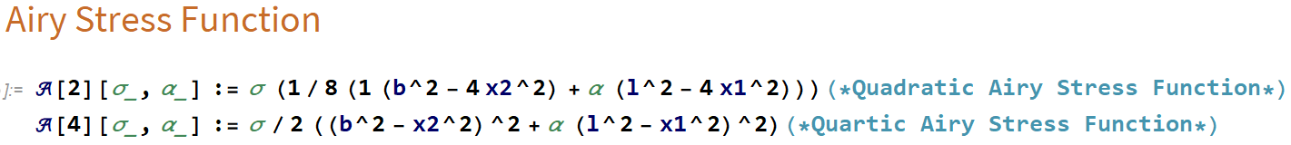
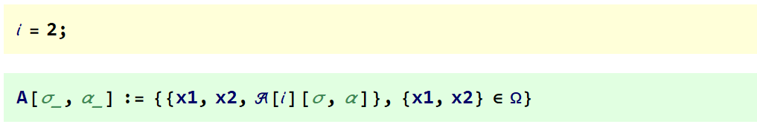
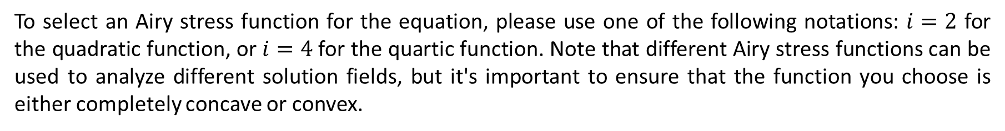
Pre-processing
Domain and Airy Stress Function Definition
To select an Airy stress function for the equation, please use one of the following notations: $i=2$ for the quadratic function, or $i=4$for the quartic function. Note that different Airy stress functions can be used to analyze different solution fields, but it's important to ensure that the function you choose is either completely concave or convex.
https://github.com/colivieri89/FORMERLY-Math
9/29

Slide 10
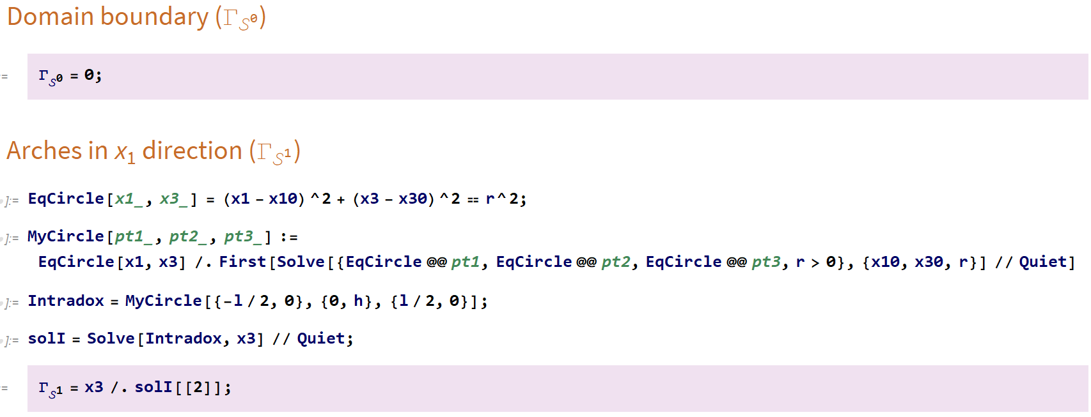
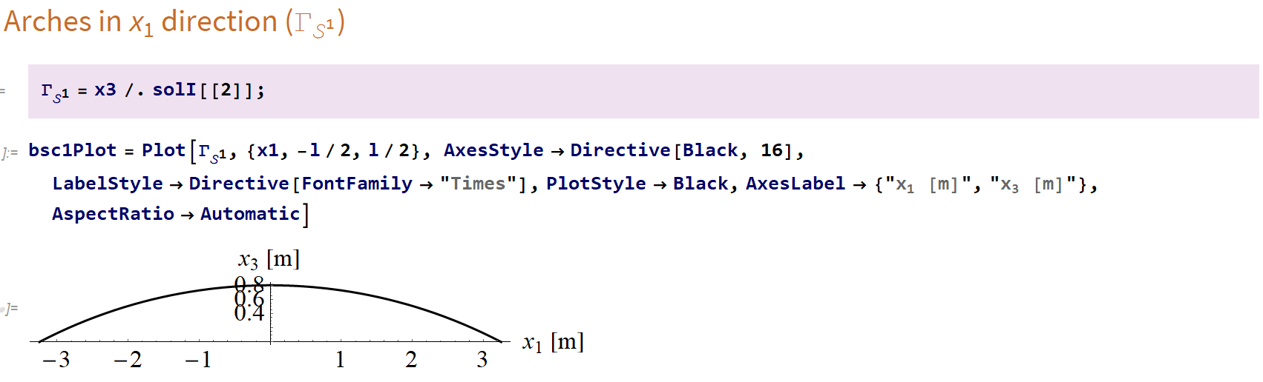
Pre-processing
Conditions $Γ_{S^{i}}$
In this sub-module three Dirichlet boundary conditions are defined:
https://github.com/colivieri89/FORMERLY-Math
10/29

Slide 11
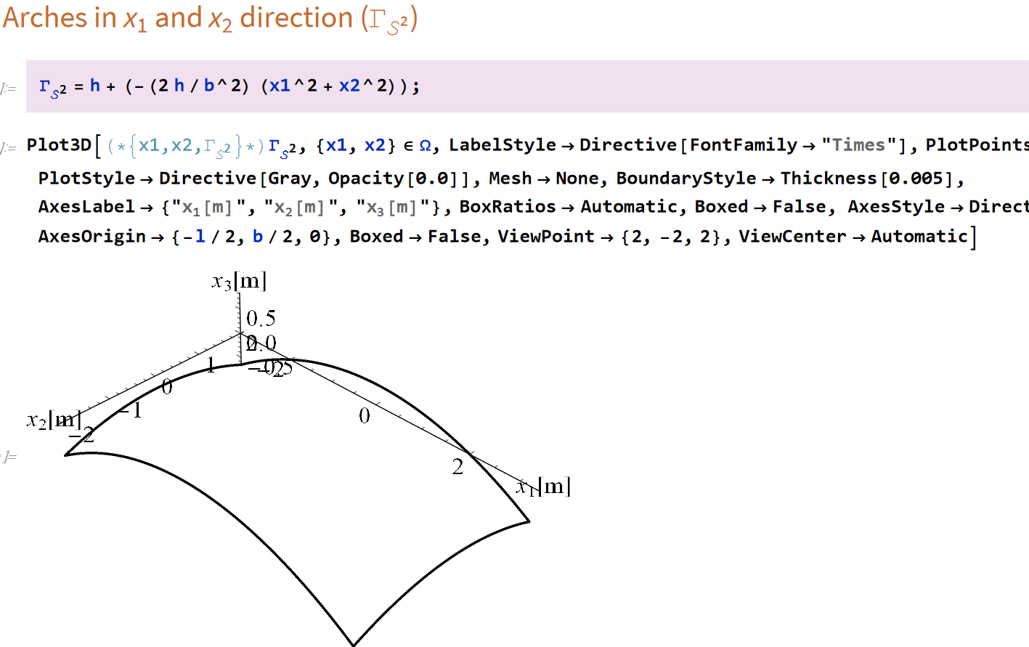
Pre-processing
Conditions $Γ_{S^{i}}$
https://github.com/colivieri89/FORMERLY-Math
11/29

Slide 12
Reference Shape Definition
https://github.com/colivieri89/FORMERLY-Math
12/29

Slide 13
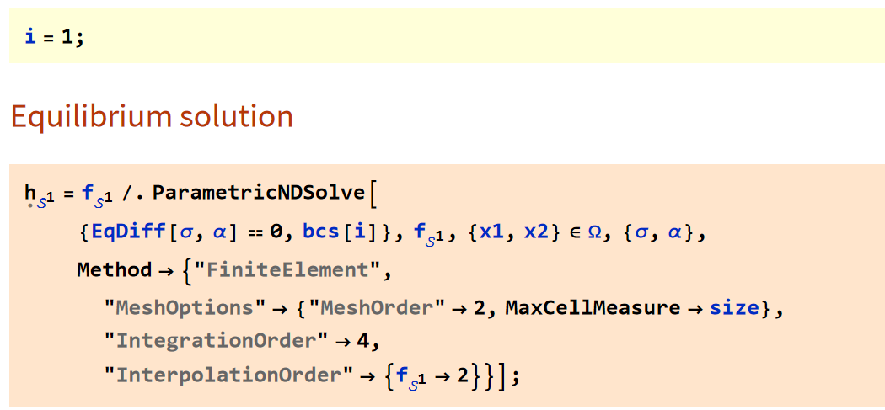
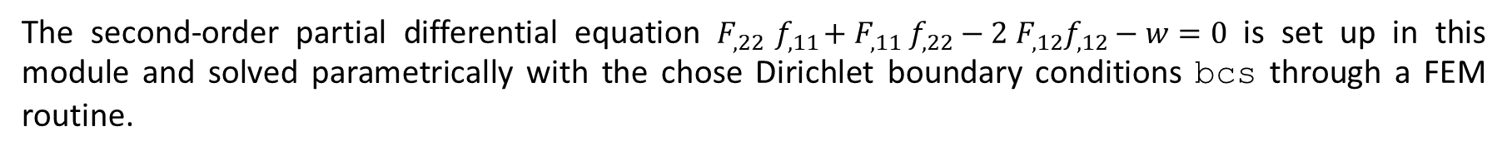
Reference Shape Definition
Transversal Equilibrium Equation Solution
The second-order partial differential equation $F_{,22}{ f}_{,11}+F_{,11} f_{,22}−2 F_{,12}f_{,12}−w=0$ is set up in this module and solved parametrically with the chose Dirichlet boundary conditions bcs through a FEM routine.
https://github.com/colivieri89/FORMERLY-Math
13/29

Slide 14
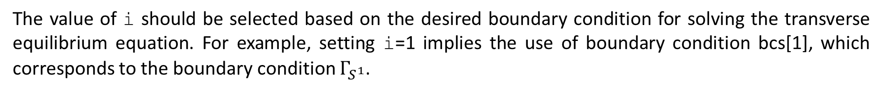
Reference Shape Definition
Transversal Equilibrium Equation Solution
The value of i should be selected based on the desired boundary condition for solving the transverse equilibrium equation. For example, setting i=1 implies the use of boundary condition bcs[1], which corresponds to the boundary condition $Γ_{S^{1}}$.
https://github.com/colivieri89/FORMERLY-Math
14/29

Slide 15
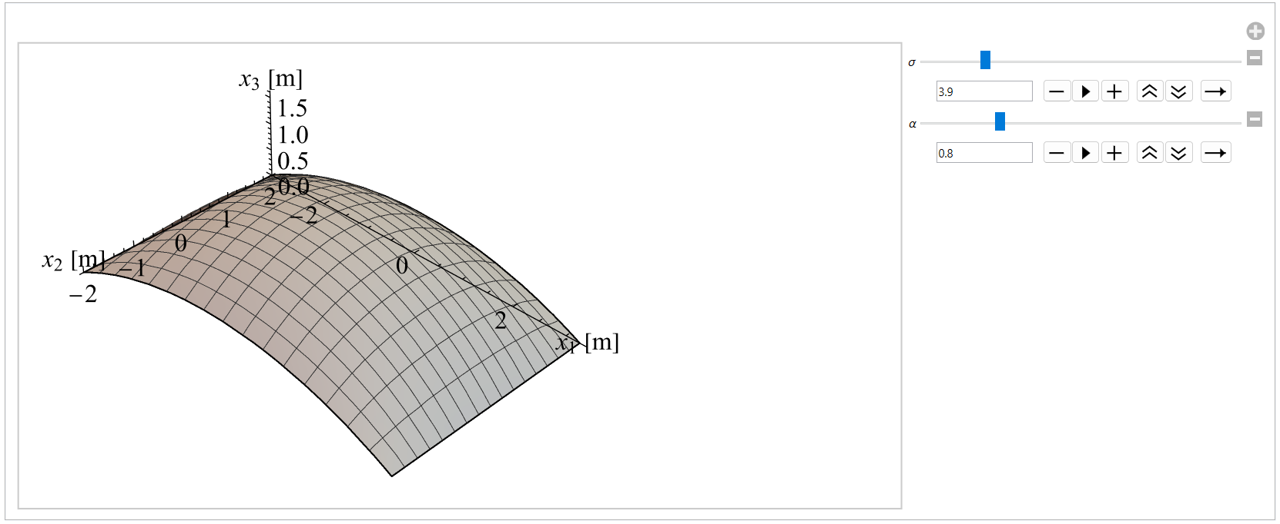
Reference Shape Definition
Reference surface selection
Through the Manipulate function, it is then possible to see how as the value of the parameters changes, the shape of the membrane changes, thus choosing the one that best reflects the user’s architectural needs. The value of the parameters chosen will then go on to define what is the reference surface for constrained form-finding
https://github.com/colivieri89/FORMERLY-Math
15/29

Slide 16
Reference Shape Definition
Reference surface selection
Assign the values of $σ$ and $α$ that visualize on the right panel of the previous output once the shape that meets the user's architectural requirements are chosen.
https://github.com/colivieri89/FORMERLY-Math
16/29

Slide 17
Constrained Form-Finding
https://github.com/colivieri89/FORMERLY-Math
17/29

Slide 18
Constrained Form-Finding
The module calculates the load associated with the reference surface and incorporates it into the parametric solution of the second-order partial differential equation using the same FEM routine as demonstrated previously. The primary objective of this module is to minimize the mean distance between the shell and the reference surface by selecting appropriate parameters through the minimization of an objective function.
https://github.com/colivieri89/FORMERLY-Math
18/29

Slide 19
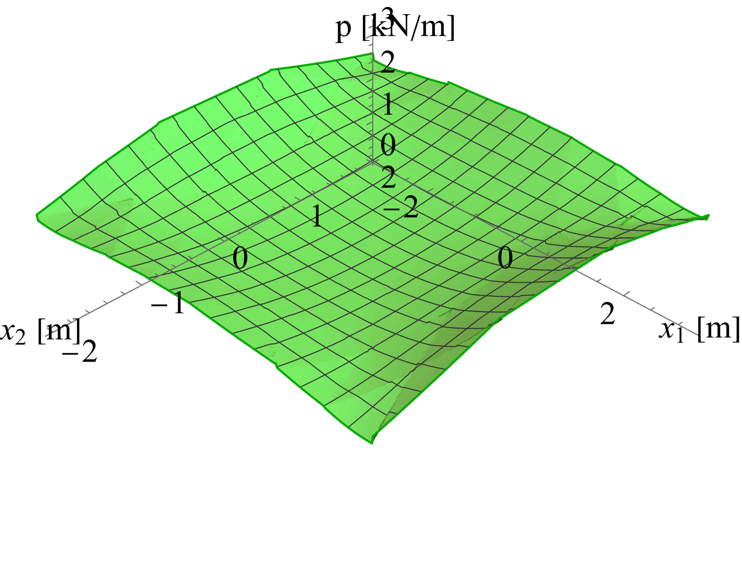
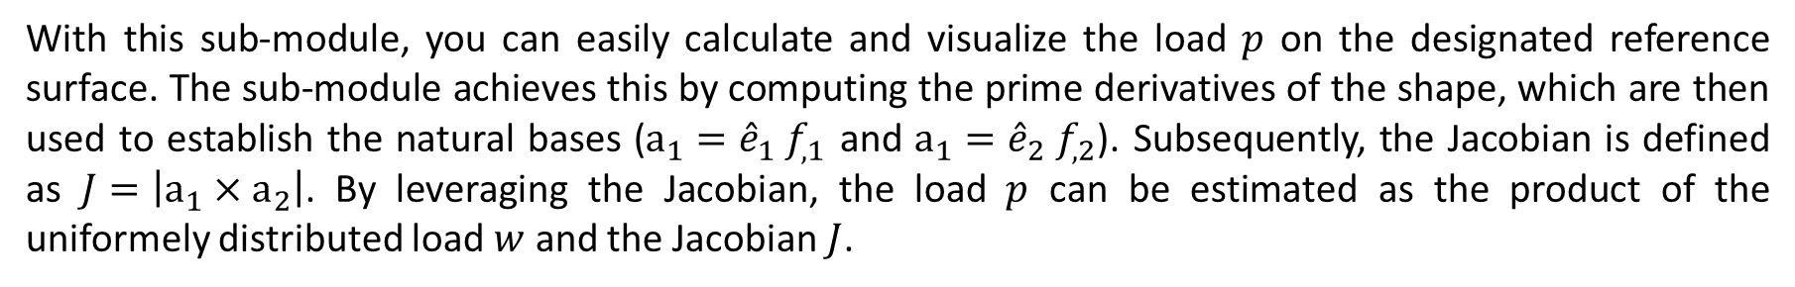
Constrained Form-Finding
Real Load Evaluation
With this sub-module, you can easily calculate and visualize the load $p$ on the designated reference surface. The sub-module achieves this by computing the prime derivatives of the shape, which are then used to establish the natural bases ($a_{1}={\hat{e}}_{1}{ f}_{,1}$ and $a_{1}={\hat{e}}_{2}{ f}_{,2}$). Subsequently, the Jacobian is defined as $J=\left|a_{1}×a_{2}\right|$. By leveraging the Jacobian, the load $p$ can be estimated as the product of the uniformely distributed load $w$ and the Jacobian $J$.
https://github.com/colivieri89/FORMERLY-Math
19/29

Slide 20
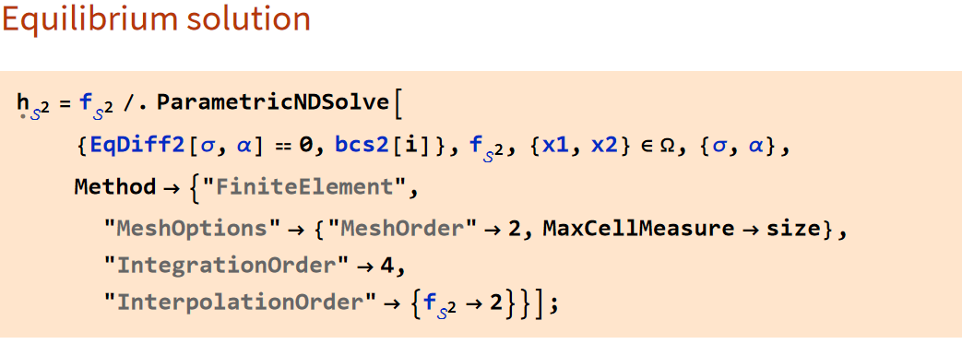
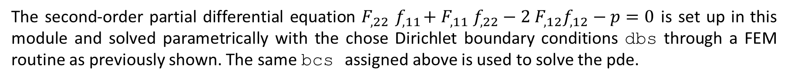
Constrained Form-Finding
Solution and parameter minimization
The second-order partial differential equation $F_{,22}{ f}_{,11}+F_{,11} f_{,22}−2 F_{,12}f_{,12}−p=0$ is set up in this module and solved parametrically with the chose Dirichlet boundary conditions dbs through a FEM routine as previously shown. The same bcs assigned above is used to solve the pde.
https://github.com/colivieri89/FORMERLY-Math
20/29

Slide 21
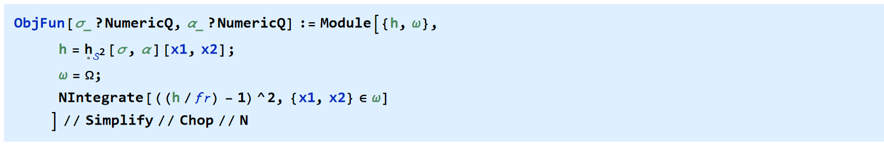
Constrained Form-Finding
Solution and parameter minimization
To define the mean square deviation between the reference shape ℎ and the optimized shape $f_{m}$, we use the objective function, ObjFun, which depends on two numerical variables: $σ$ and α.
https://github.com/colivieri89/FORMERLY-Math
21/29

Slide 22
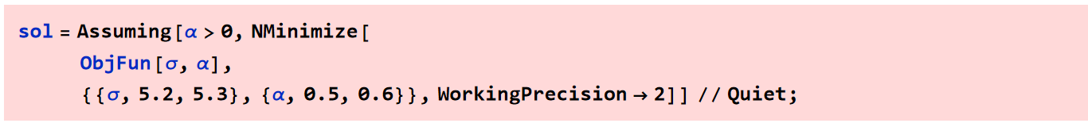
Constrained Form-Finding
Solution and parameter minimization
Finally, the function ObjFun is minimized over the specified range of values for σ and α, with a working precision of two decimal places. It is suggested to assign solution range values of σ and α close to those assigned in RuleSol. The result of tThe robustness and efficiency of the FEM approach can be
The robustness and efficiency of the FEM approach can be measured by the error norm, which is the average distance between the approximate and exact solutions. If the error norm is below a predetermined tolerance, such as 1%, it indicates a highly accurate, robust, and efficient solution. This value can be read from the output of the function DistPerc.
https://github.com/colivieri89/FORMERLY-Math
22/29

Slide 23
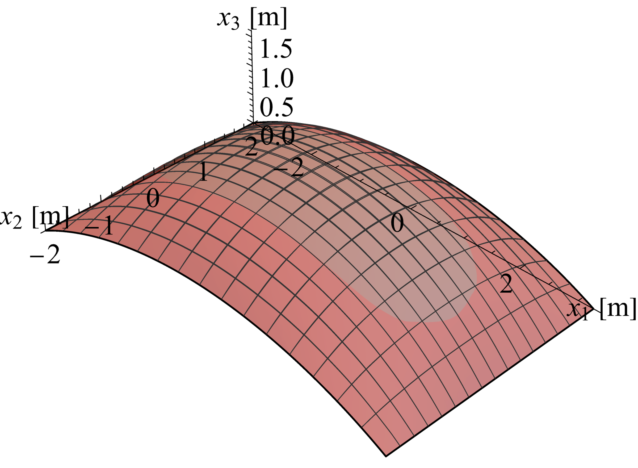
Constrained Form-Finding
Solution and parameter minimization
Is then possible to plot the form-finded final surface $f_{m}$ (red) compared with the reference one (grey).
https://github.com/colivieri89/FORMERLY-Math
23/29

Slide 24
Stresses evaluation and outputs
https://github.com/colivieri89/FORMERLY-Math
24/29

Slide 25
Stresses evaluation and outputs
The last module of this code allows us to calculate the tensor of the stresses acting on the membrane and to evaluate and plot its eigenvalues and eigenvectors. This part provides fundamental data for the final design of the structure.
https://github.com/colivieri89/FORMERLY-Math
25/29

Slide 26
Stresses evaluation and outputs
Stress tensor, eigenvalues, and eigenvectors
After obtaining the final surface, it is possible to evaluate its stress tensor and generate DensityPlot and StreamPlot graphs of the surface's eigenvalues and eigenvectors, respectively.
https://github.com/colivieri89/FORMERLY-Math
26/29

Slide 27
Examples
https://github.com/colivieri89/FORMERLY-Math
27/29

Slide 28
Stresses evaluation and outputs
Example 1
Data: $b=4 m$, $l=6.5 m$, $h=0.8 m$, $t=0.12 m$, $ρ_{a}=18 kN/m^{3}$, size$=0.5$, $𝒜\left[2\right]$, $Γ_{S^{1}}$, $σ=3.9$, $α=0.8$
https://github.com/colivieri89/FORMERLY-Math
28/29

Slide 29
Stresses evaluation and outputs
Example 1
Data: $b=10 m$, $l=15 m$, $h=1.4 m$, $t=0.20 m$, $ρ_{a}=24 kN/m^{3}$, size$=0.4$, $𝒜\left[4\right]$, $Γ_{S^{2}}$, $σ=3.9$, $α=0.8$
https://github.com/colivieri89/FORMERLY-Math
29/29

